Slide 1
Sampling Based Kino-Dynamic Planning For Self-Driving Cars
- LakshMAN KUMAR

Slide 2
Introduction
Motivation
Driverless Cars will reduce the number of accidents
Time spent commuting can be spent for doing other useful things
Goal
To generate a path from the source to the destination, that takes the dynamics of the car into account

Slide 3
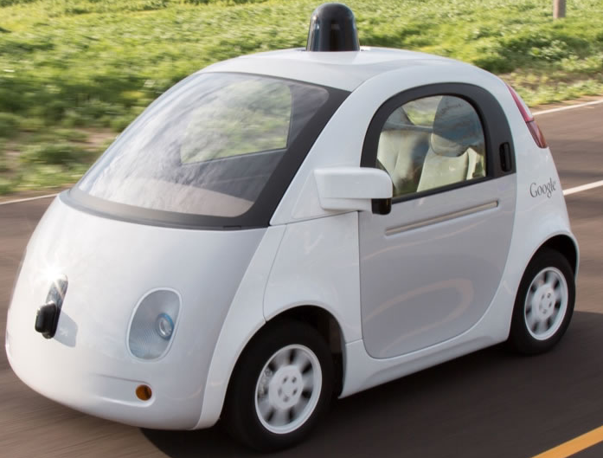
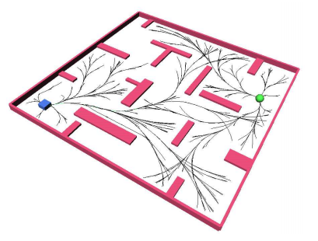
Related Works
Images From
[1] Google, “Self-Driving Car” , https://www.google.com/selfdrivingcar/
[2] Steven.M.LaValle and James.J.Kuffner Jr, “Randomized Kino-Dynamic Planning” , International Journal of Robotics Research 2001

Slide 4
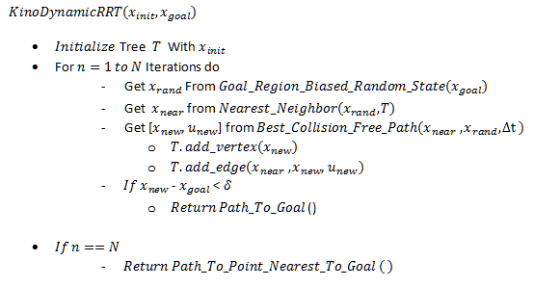
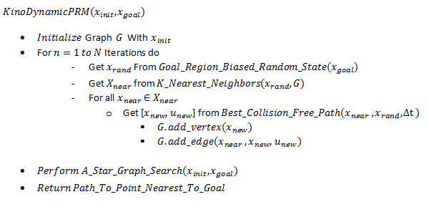
Approaches
Kino-Dynamic RRT Kino-Dynamic PRM

Slide 5
Design Of Experiments
Input
Starting Configuration
Goal Configuration
Map ( Obstacles)
Output
Trajectory from Starting Configuration to Destination Configuration based on Ackermann Steering Model
Experiments
Variation of number of obstacles in the map
Variation of the shape of obstacles
Variation of the starting and goal configurations
Variation of parameters, like time step size, random number generator and number of neighbors, in the algorithm

Slide 6
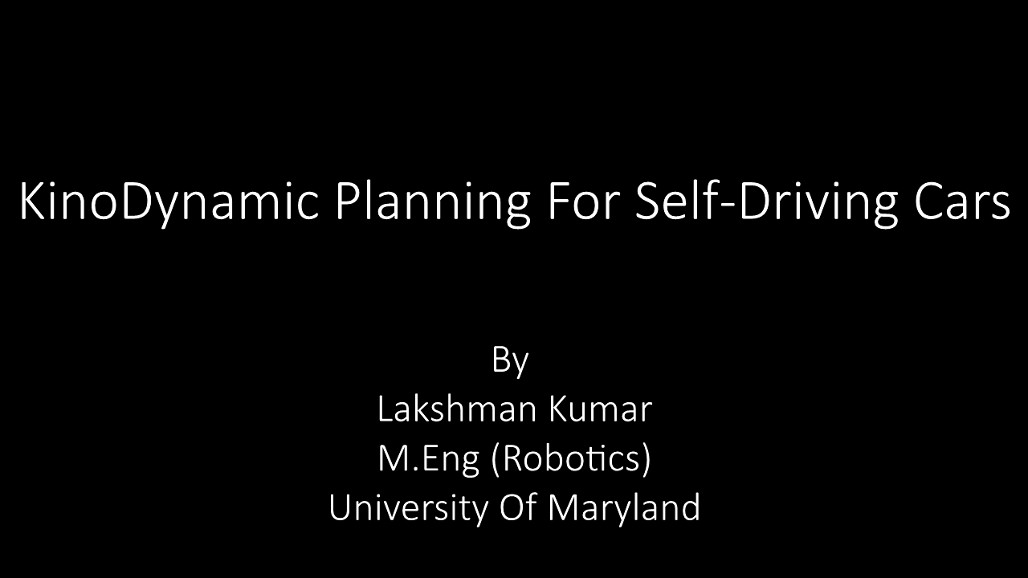
Results

